Slide 1

Final Project - DATA 602
Employee Layoffs Since Covid19

Slide 2

Project - Employee Layoffs Since Covid19
Overview :
The Recent News that META laid off employees in large number. Let’s see what caused that
The layoffs are suspected to be caused by the Federal Interest Rate.

Slide 3
Data Set
Data Set contains 1731 rows and 9 columns
The data has few null values and some unwanted rows. They have been removed and has been filtered to the country United States
It got characteristics such as
Company
Location
Industry
total_laid_off
percentage_laid_off
Date
Stage
Country
funds_raised
FedDate
interestRate
Data Source
DATASET 1 : https://www.kaggle.com/datasets/swaptr/layoffs-2022
DATASET 2 : https://fred.stlouisfed.org/series/FEDFUNDS

Slide 4
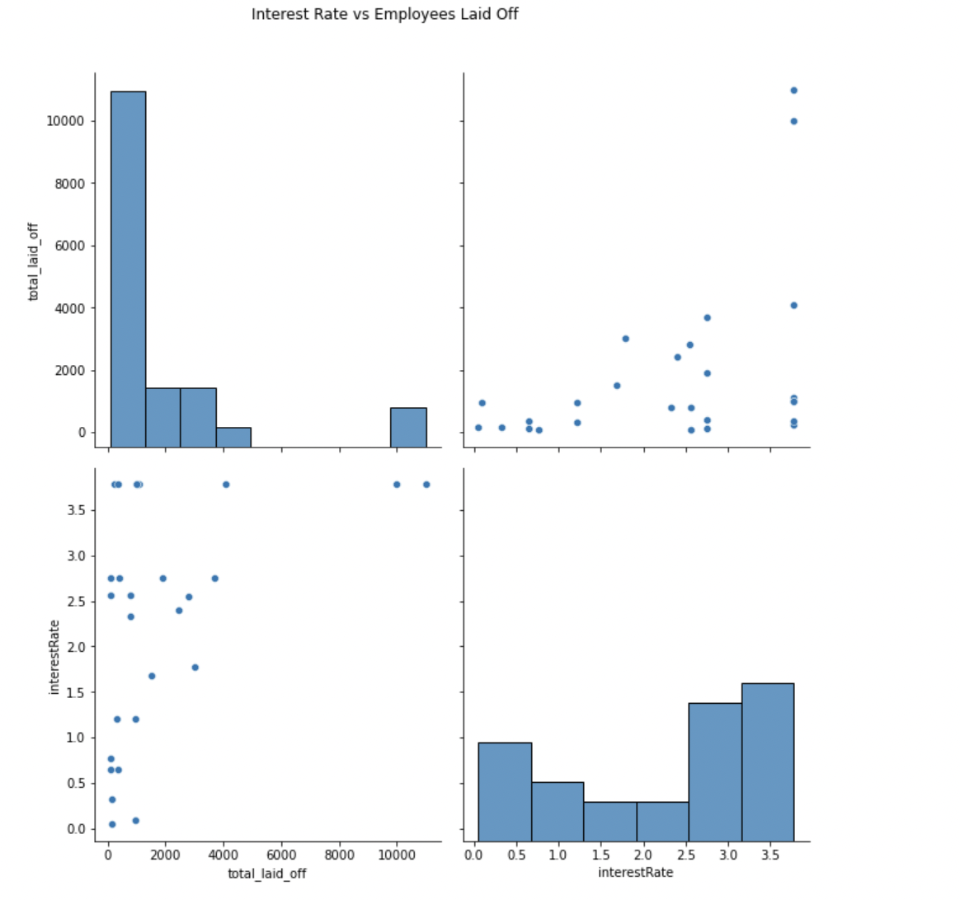
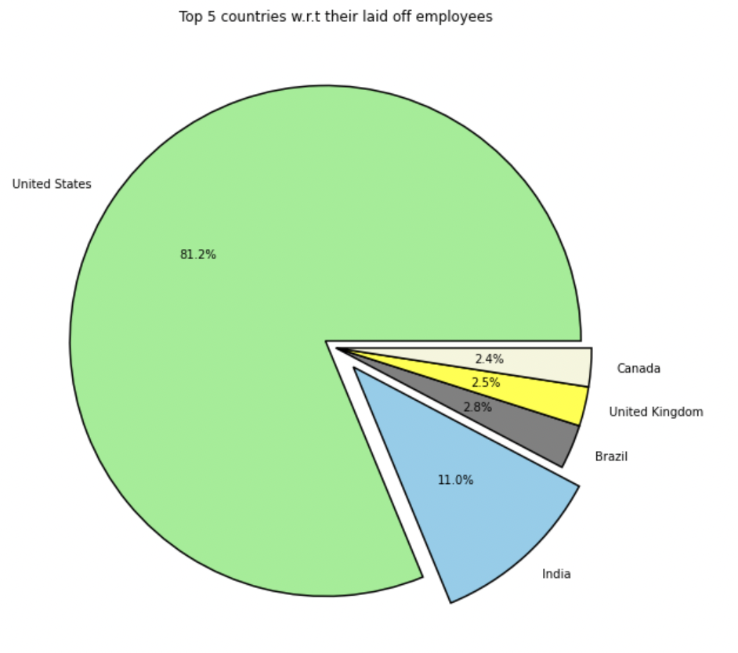
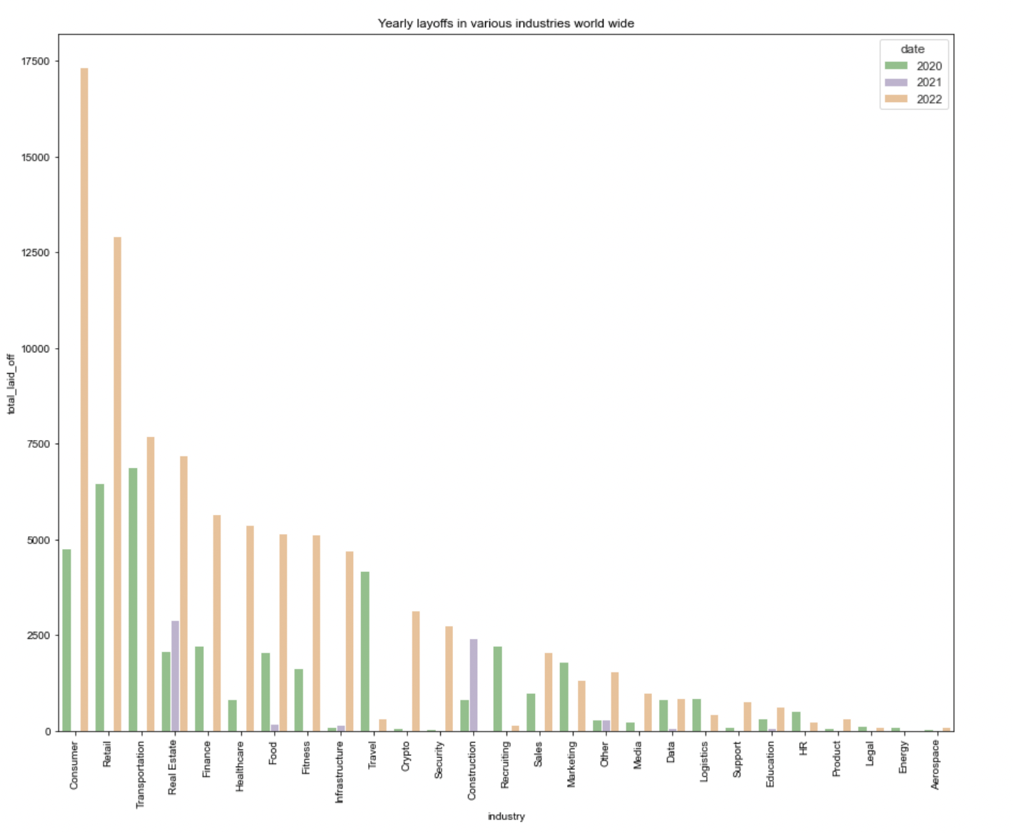
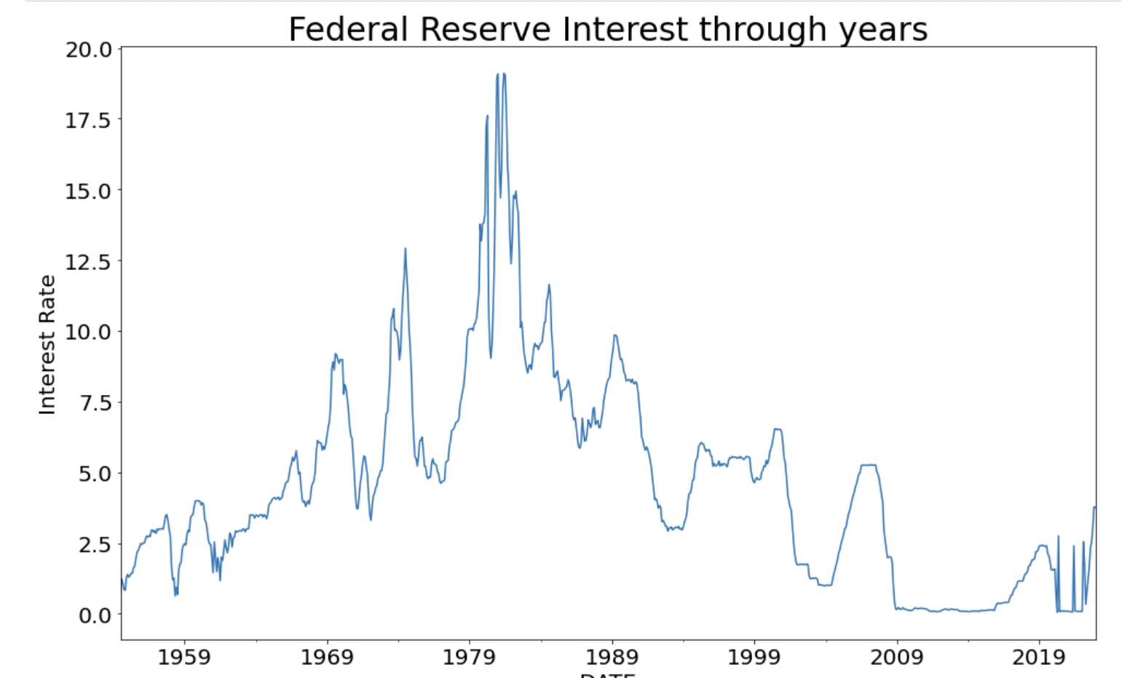
Visualizations

Slide 5
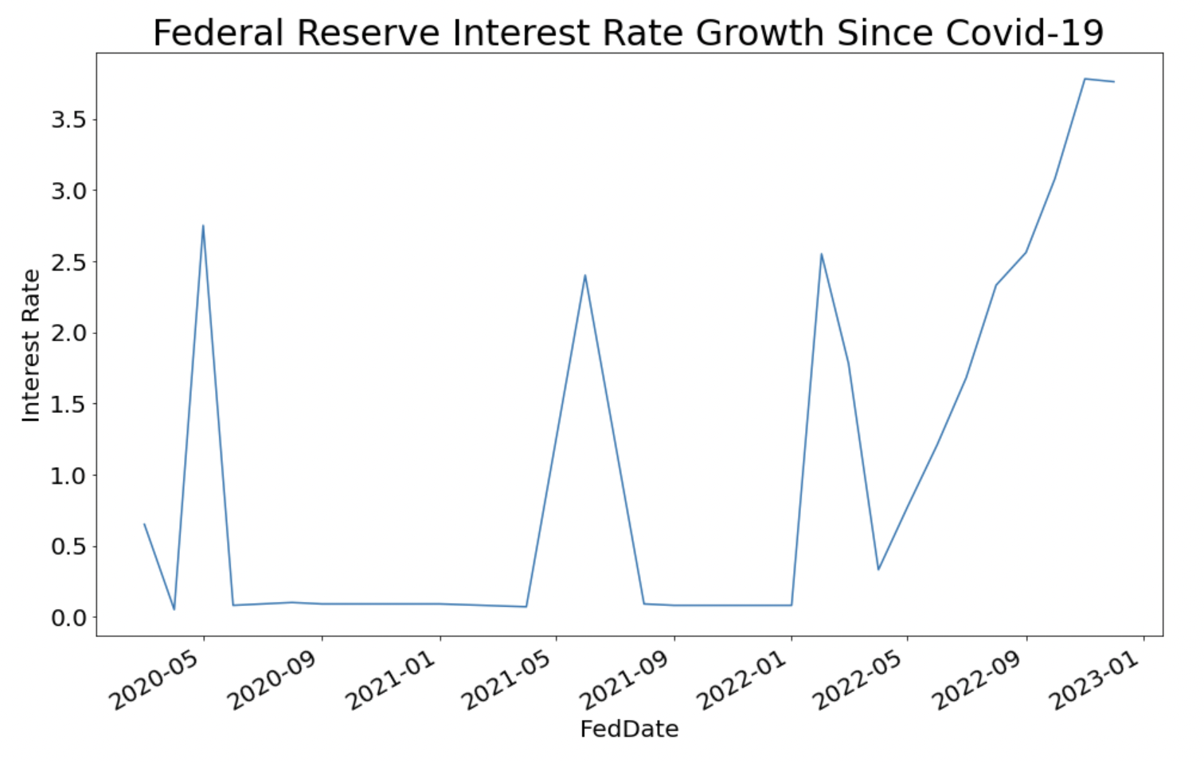
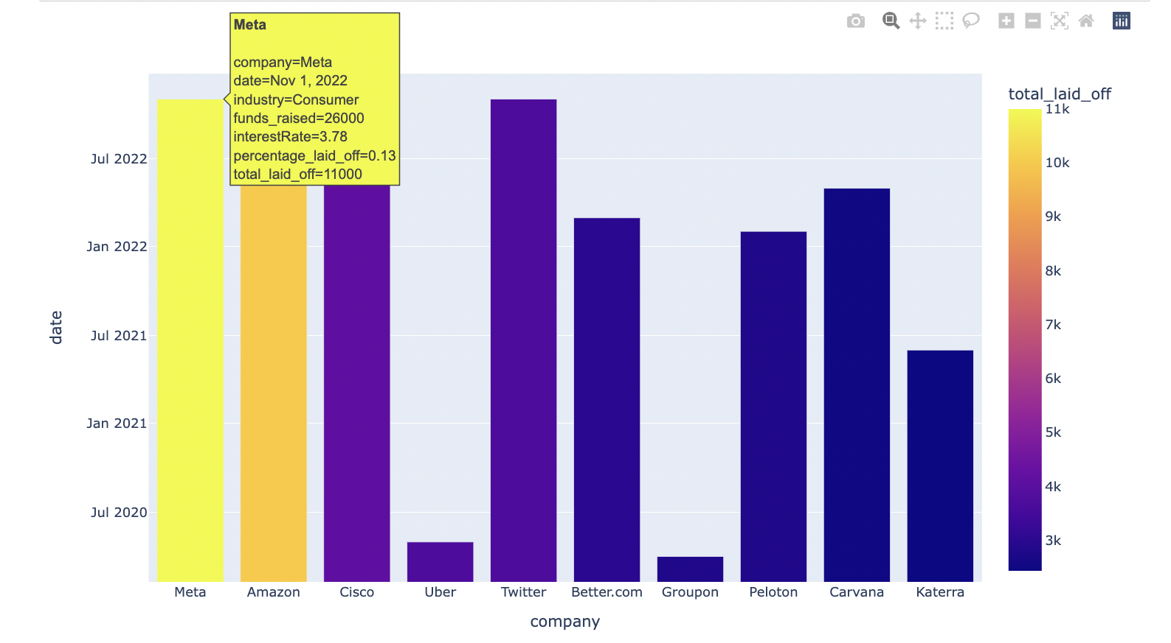
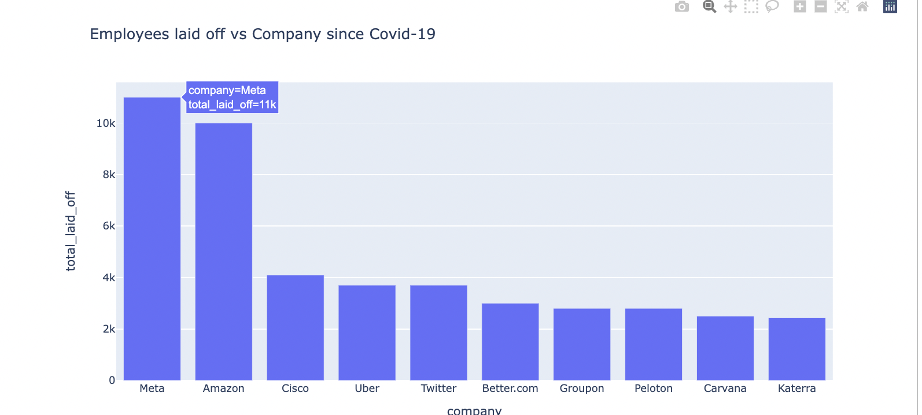
MORE VISUALISATIONS

Slide 6

Machine Learning Models
Three models has been used in this project to predict and conclude if interest rate alone is the reason for laying off employees
Models being used are
Linear Regression
KNN
Decision Tree

Slide 7

Linear Regression
Metrics
Mean Squared Error: 0.051707875316333314
Mean Absolute Error: 0.15138676302363666
R-squared: 0.011363819015939858
Mean Squared Error (MSE): In this case, the MSE is 0.0517, which indicates that, on average, the predicted values deviate from the actual values by approximately 0.0517.
Mean Absolute Error (MAE): MAE is 0.1514, which means that, on average, the predicted values deviate from the actual values by approximately 0.1514.
R-squared: In this case, the R-squared value is 0.0114, which suggests that only around 1.14% of the variability in the target variable can be explained by the linear regression model using the interest rate feature. A higher R-squared value closer to 1 indicates a better fit of the model to the data.

Slide 8
KNN Model
Metrics
Mean Squared Error: 0.04672997929411765
Mean Absolute Error: 0.1541529411764706
R-squared: 0.10653942007538819
Mean Squared Error (MSE): The MSE of 0.0485 indicates that, on average, the predicted values from the KNN model deviate from the actual values by approximately 0.0485. A lower MSE value indicates better performance.
Mean Absolute Error (MAE): The MAE of 0.1551 suggests that, on average, the predicted values deviate from the actual values by approximately 0.1551. Similar to MSE, a lower MAE value indicates better performance.
R-squared: The R-squared value of 0.0731 indicates that around 7.31% of the variability in the target variable can be explained by the KNN model using the selected features. A higher R-squared value closer to 1 indicates a better fit of the model to the data.

Slide 9
Decision Tree Model
Metrics
Mean Squared Error: 0.04975417378158228
Mean Absolute Error: 0.15037267287527384
R-squared: 0.04871789733152754
Mean Squared Error (MSE): It measures the average squared difference between the predicted and actual values. In this case, the MSE is 0.0497, indicating that, on average, the predicted values deviate from the actual values by this amount squared.
R-squared It represents the proportion of the variance in the target variable (percentage_laid_off) that can be explained by the independent variable (interestRate) in the model. The R-squared value of 0.0487 suggests that only a small portion of the variance in the percentage of layoffs can be explained by the interest rate.
Mean Absolute Error (MAE): It measures the average absolute difference between the predicted and actual values. Here, the MAE is 0.1504, indicating that, on average, the predicted values deviate from the actual values by this amount.

Slide 10
Conclusion and Summary
Almost all the industries have higher lay offs in 2022 compared to the two years before that.
In comparison to the rest of the globe, the United States experienced the most layoffs, followed by India. More than 75% of the employees laid off since 2020 are from the United States.
In 2022, the consumer industry in the United States has struck the hardest by layoffs.
In 2022, the travel industry saw much fewer layoffs internationally.

Slide 11
Conclusion and Summary
It is important to consider other factors and potentially explore more sophisticated models to improve the prediction accuracy.
Based on this, we should expect a mild recession in the middle of 2023 as a result of the Federal Reserve raising interest rates, continued inflation, and the uncertainties surrounding China as well as Russia's war in Ukraine.
However, the models suggesting that there might be other factors or variables influencing the layoffs that are not captured in the data.

Slide 12

Prediction Result
Finally, an increase in the Federal Reserve Interest Rate, which controls a company's funding, is only a small factor in META's layoffs, but there might be other things which caused this.

Slide 13

References
https://scikit-learn.org/stable/index.html
https://www.kaggle.com/datasets/theakhilb/layoffs-data-2022
https://www.kaggle.com/datasets/swaptr/layoffs-2022
https://fred.stlouisfed.org/series/FEDFUNDS
https://www.dataquest.io/blog/understanding-regression-error-metrics/
https://www.datacamp.com/community/tutorials/graph-visualization-python

Slide 14

Thank you

